Slide 1





















CI/CD toolchain
Source
Build
Deploy
Environments
App
Ops
GitHub
Codeplex
Microsoft Azure
Puppet Labs
ONE CONSISTENT PLATFORM
Jenkins
Hudson
Chef
ON-PREMISES
SERVICE PROVIDER
Configuration
Alerting
Production/Stage
Visual Studio
Jenkins
Hudson
Zabbix
Monitor
Test/issues
PowerShell
Visual Studio
Vagrant
Visual Studio
Puppet Labs
Eclipse
Grunt
Gradle
Process tools
Dev/Test
Redmine
JIRA

Slide 2
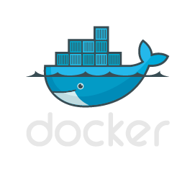



TFVC
GIT
PowerShell
Vagrant
Release Manager

